Slide 1

NLP中的对抗训练
梁宇航 2020.7.7

Slide 2
内容概要：
1.对抗样本和对抗训练介绍
- 对抗样本和防御方式概述
- 几个生成对抗样本的方法
- 对抗训练的发展
2.NLP的对抗训练方法
- PGD(最普通的)
- FreeAT 和 YOPO(PGD的变种)
- FreeLB

Slide 3
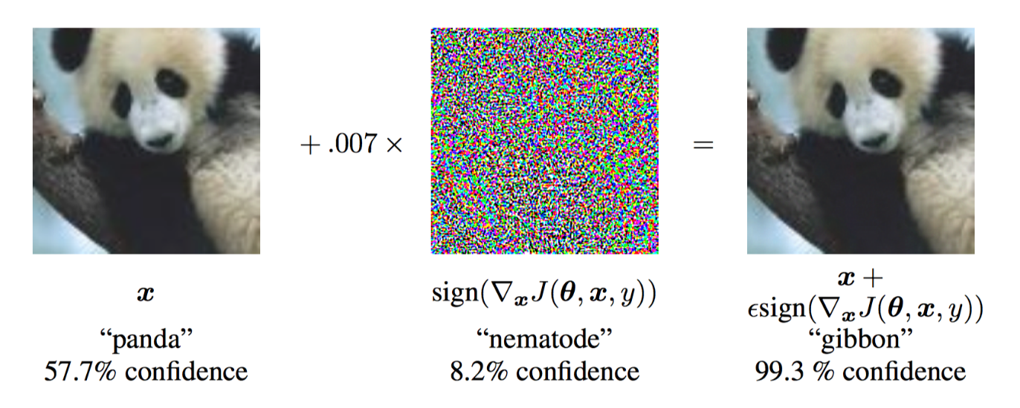
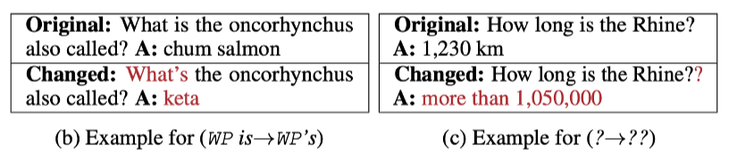
1.对抗样本和对抗训练
（CV）
对抗样本
（NLP）
Ian Goodfellow, Jonathon Shlens, and Christian Szegedy. Explaining and harnessing adversarial examples. ICLR, 2015.
Christian Szegedy, Wojciech Zaremba, Ilya Sutskever, Joan Bruna, Dumitru Erhan, Ian Goodfellow, and Rob Fergus. Intriguing properties of neural networks. ICLR, 2014

Slide 4
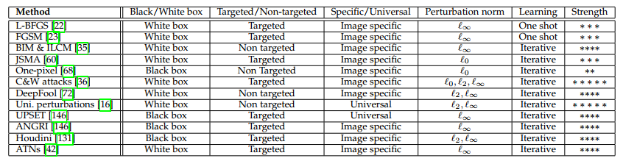
Brute-force adversarial training
Data compression as defense
Foveation based defense
Data randomization and other methods
……
按知识
黑盒攻击和白盒攻击
攻击
按目标
目标攻击和非目标攻击
对抗样本
Deep Contractive Networks
Gradient regularization/masking
Defensive distillation
Biologically inspired protection
Parseval Networks
……
Modifying training/input(样本去噪、对抗训练等)
防御
Modifying the network(梯度遮蔽等)
Using additional network(基于GAN的防御等)
Defense against universal perturbations
GAN-based defense
Detection Only approaches
……
Naveed Akhtar and Ajmal Mian, Threat of Adversarial Attacks on Deep Learning in Computer Vision: A Survey, 2018

Slide 5
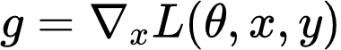
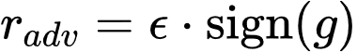
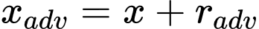
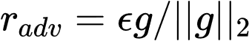

FGSM (Fast Gradient Sign Method)
FGM (Fast Gradient Method)
PGD (Projected Gradient Descent)

Slide 6
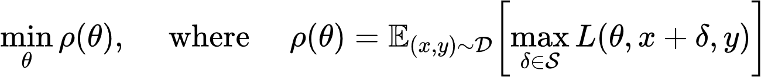
对抗训练理论化
inner-max: 目标是找到原始clean数据中所对应的对抗样本，使其能够实现最大程度干扰模型
outer-min: 目标是寻找到合适的网络参数，使得模型的robustness提升
想让模型更Robust，可在训练过程中动态生成对抗样本并利用它们训练模型
Aleksander Madry, Aleksandar Makelov, Ludwig Schmidt, Dimitris Tsipras, and Adrian Vladu. Towards Deep Learning Models Resistant to Adversarial Attacks. ICLR, 2018

Slide 7
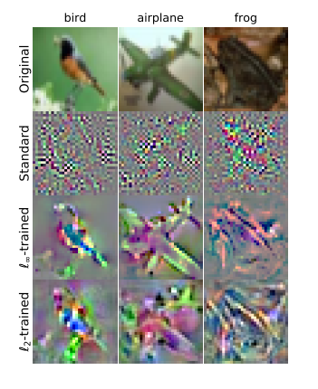
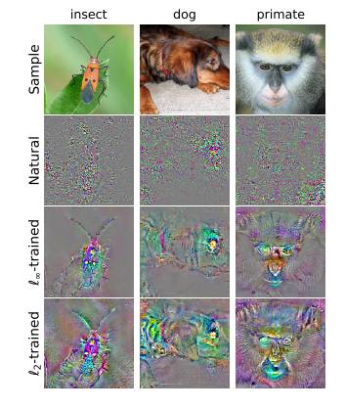
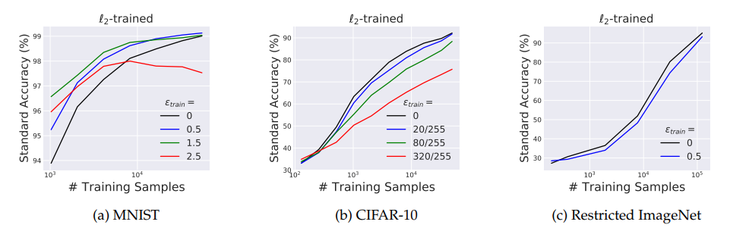
Robustness May Be at Odds with Accuracy?
对抗训练作用
Robustness提高了，但是generalization受到了影响。
Tsipras, Madry. Robustness may be at odds with accuracy. ICLR 2019

Slide 8
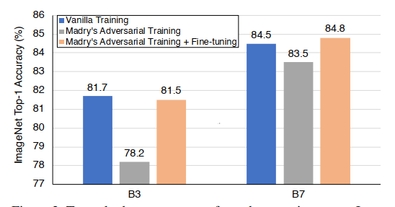
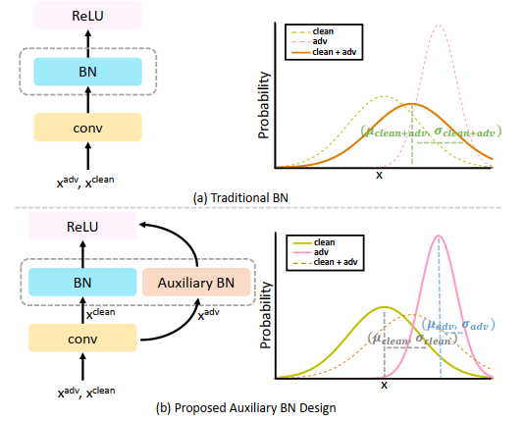
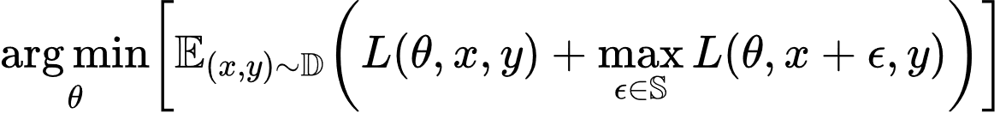
Adversarial Examples Improve Generalization
文章认为是干净样本和对抗样本分布不匹配，阻止了
模型从两个分布域准确、有效地提取有价值的特征
干净样本损失和对抗样本损失都加入训练：
对clean样本和adv样本使用
不同BatchNorm
Adversarial Examples Improve Image Recognition，arXiv:1911.09665

Slide 9
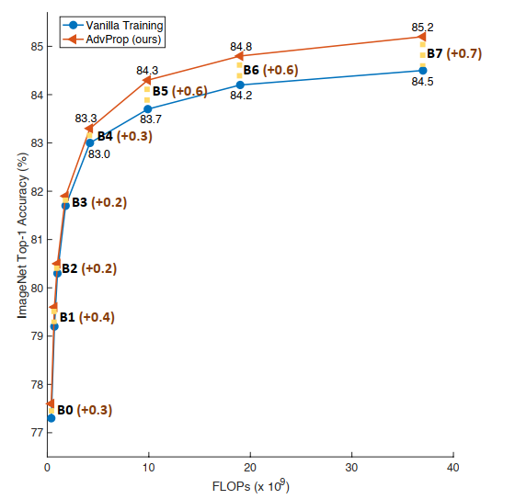
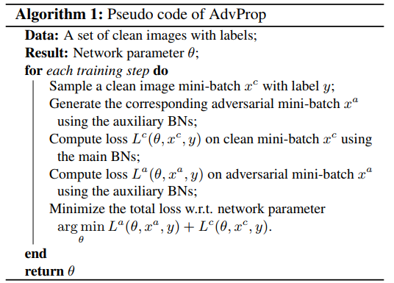
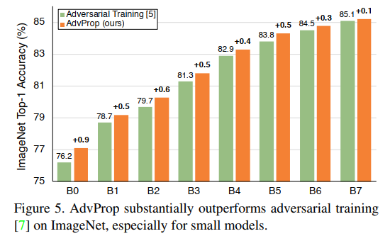
AdvProp:
results
Conclusion：Adversarial training Improve both Generalization and Robustness

Slide 10
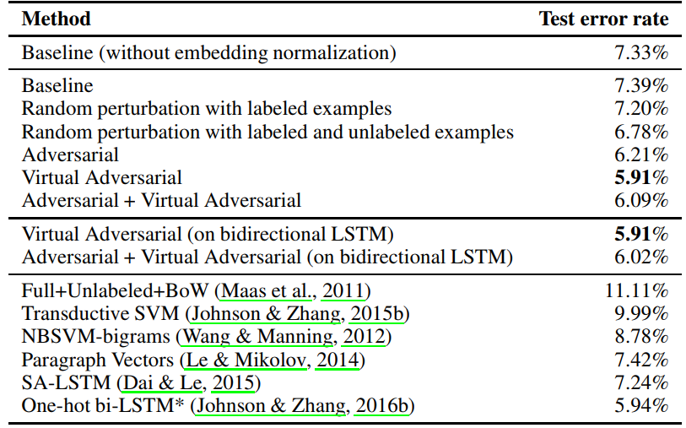
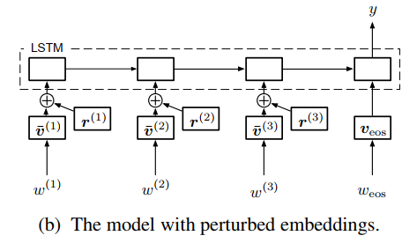

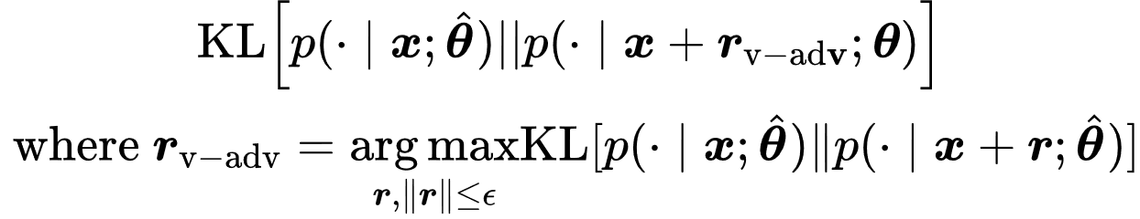
Add adversarial perturbations in Embeddings
语义等价生成对抗样本效率太低，而且攻击效果也不够强
IMDB
Adversarial training
Virtual Adversarial training
Takeru Miyato, Andrew M Dai, and Ian Goodfellow. Adversarial Training Methods for Semi-Supervised Text Classification. ICLR,2017

Slide 11
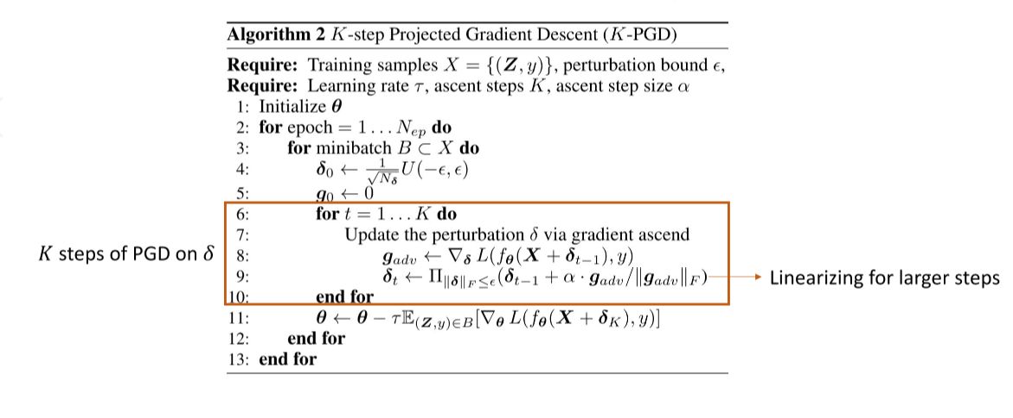
2.NLP对抗训练方法
K-step PGD(Projected Gradient Descent)
K-PGD的优缺点：
非常简单并且有效。但是比较消耗计算，是普通训练的K倍

Slide 12
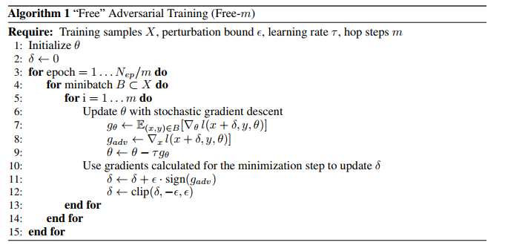
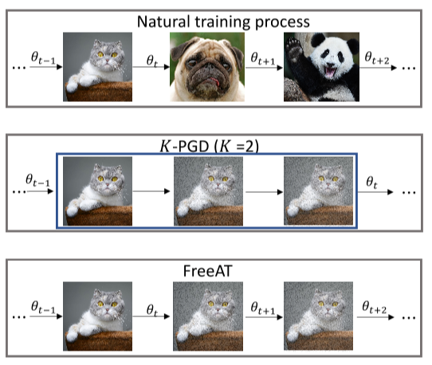
Gradient ascent 阶段对输入的embedding求梯度，在这个过程中也可以得到所有神经网络参数的梯度。可以把这些用到Gradient descent过程，减少计算量。
FreeAT(Free Adversarial Training)
对比
每对扰动做一次ascent，同时descent更新一下模型参数，
这样总的descent过程不会增加，训练时间和普通训练相当。
Adversarial Training for Free!, NeurIPS 2019

Slide 13
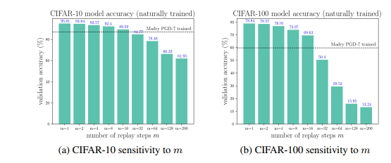
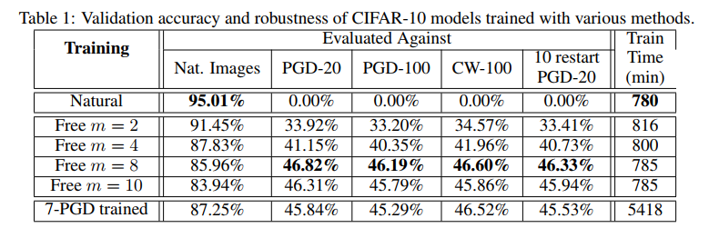
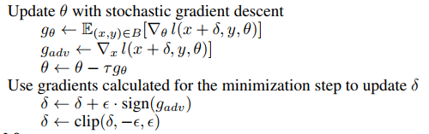
FreeAT优缺点：速度相比k-PGD提高了，但是会在一个样本附近多次更新参数。
还有一个问题就是参数的滞后更新：

Slide 14
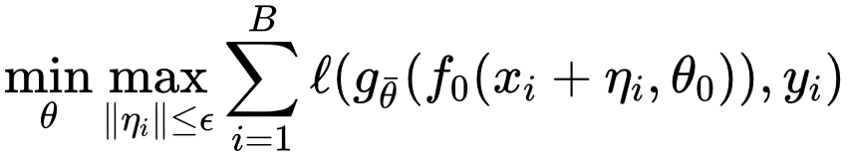
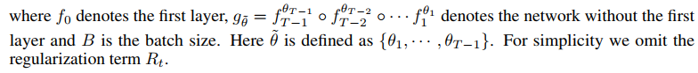
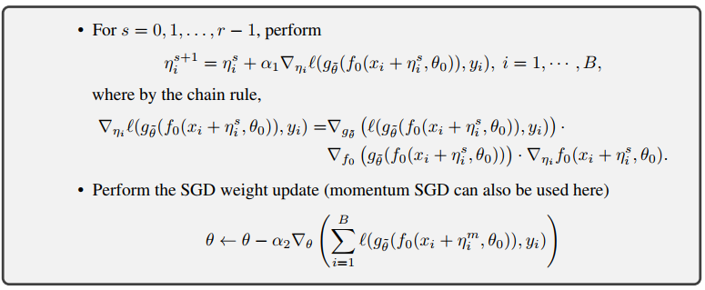
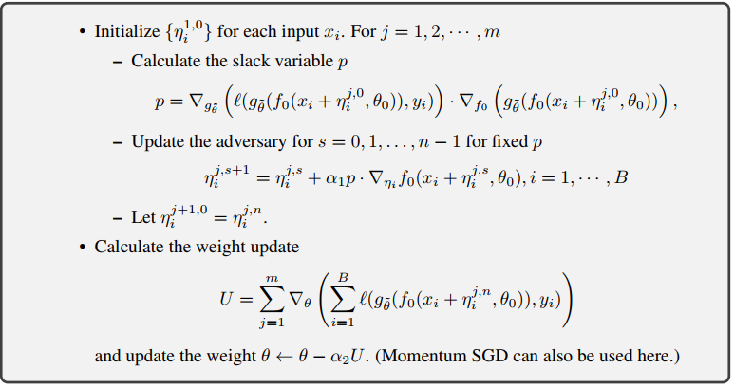

YOPO(You Only Propagate Once)：
它将神经网络看作动力学系统。这个方法的优点是在优化网络参数时，层之间是解藕的。通过这个思想，既然扰动是加在embedding层的，更新扰动时就无须计算完整的前后向传播。
减
少
计
算
正
反
向
传
播
次
数
PGD-innerMax过程
梯度下降版本YOPO-innerMax过程
You Only Propagate Once: Accelerating Adversarial Training via Maximal Principle , NeurIPS 2019

Slide 15
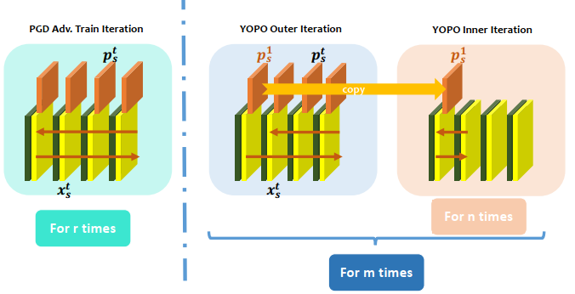
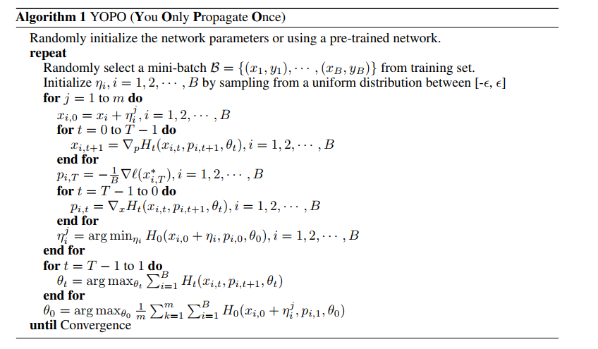
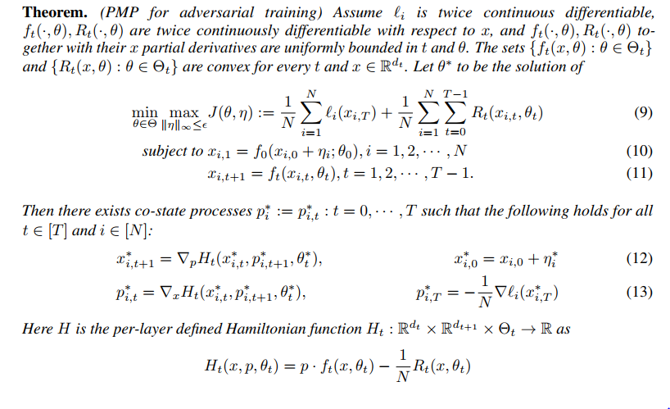
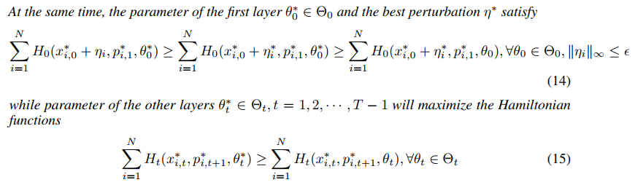
PMP版本YOPO
梯度下降版YOPO 是 PMP-YOPO的特例。。。

Slide 16
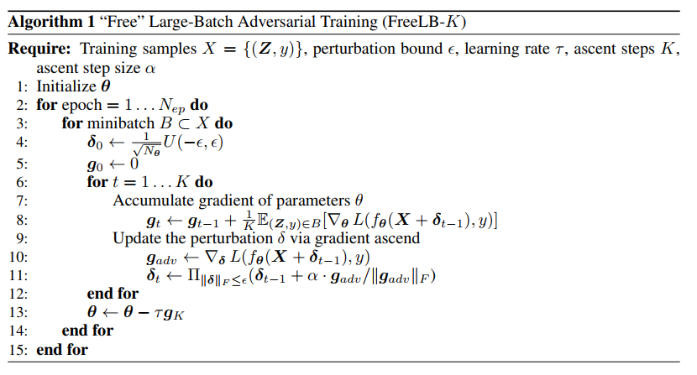
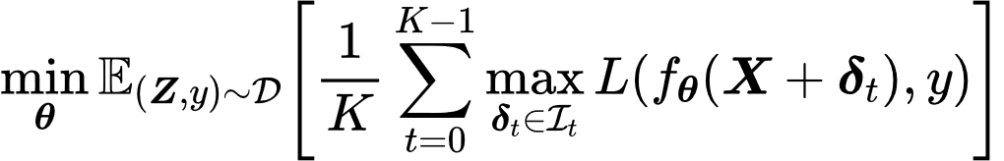
FreeLB(Free Large Batch)：
这里每一步对抗训练的gradient都保留
下来，PGD中只保留了最后一步gradient
与PGD完全相同
相对于PGD算法，FreeLB算法保留了每步对抗训练的梯度（并且获取这些每步的梯度是没有花销的，相对PGD而言）
，并且均参与了网络参数的更新。而每一步对抗训练的梯度是由当前步对抗训练样本计算而来，对从模型更新的角
度来说，相当于将训练样本扩大了k倍。
FreeLB: Enhanced Adversarial Training for Language Understanding，ICLR 2020

Slide 17
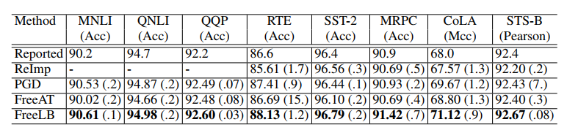
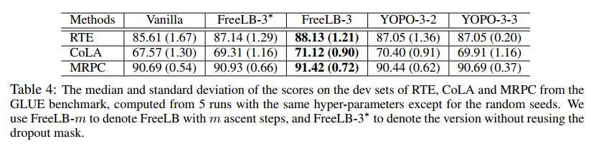
Results on the GLUE dev sets:
考虑到Dropout 对训练的影响：
在inner-max阶段，需要Fix dropout mask after first step.

Slide 18
参考文献：
Adversarial Examples Improve Image Recognition, arXiv:1911.09665
Tsipras, Madry. Robustness may be at odds with accuracy. ICLR 2019
Takeru Miyato, Andrew M Dai, and Ian Goodfellow. Adversarial training methods for semisupervised text classification. In ICLR, 2017.
Aleksander Madry, Aleksandar Makelov, Ludwig Schmidt, Dimitris Tsipras, and Adrian Vladu. Towards Deep Learning Models Resistant to Adversarial Attacks. ICLR, 2018
Naveed Akhtar and Ajmal Mian, Threat of Adversarial Attacks on Deep Learning in Computer Vision: A Survey, 2018
Ian Goodfellow, Jonathon Shlens, and Christian Szegedy. Explaining and harnessing adversarial examples. ICLR, 2015. Christian Szegedy, Wojciech Zaremba, Ilya Sutskever, Joan Bruna, Dumitru Erhan, Ian Goodfellow, and Rob Fergus. Intriguing properties of neural networks. ICLR, 2014

Slide 19
THANKS
谢谢!

